Slide 1


Slide 2
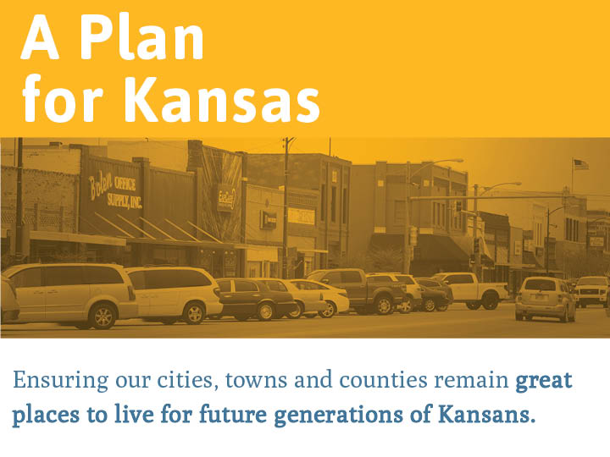

Slide 3


Slide 4
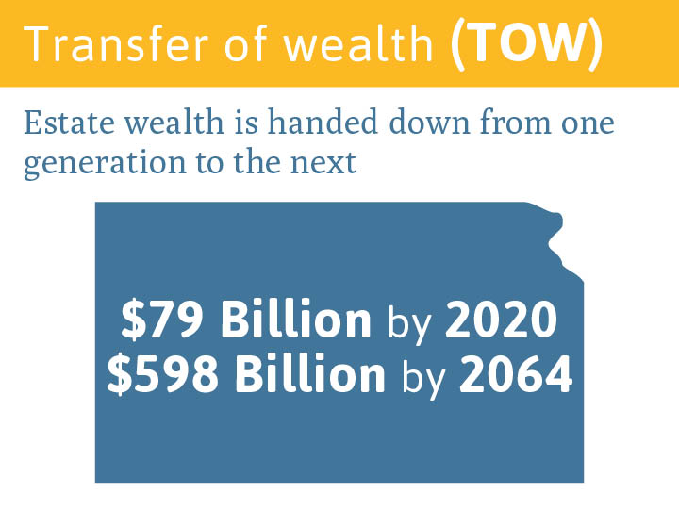
$466.7 Billion by 2032
$3.5 Trillion by 2075

Slide 5

TOW potential for
[county]
$[XX thousand/million] by 2032
$[XX thousand/million] by 2075

Slide 6


Slide 7
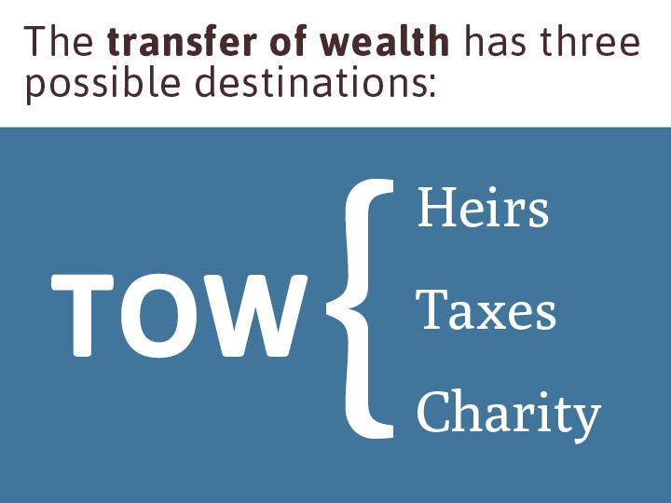

Slide 8
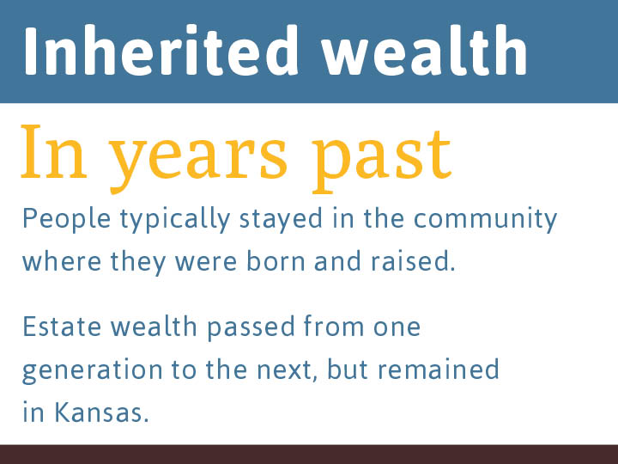

Slide 9
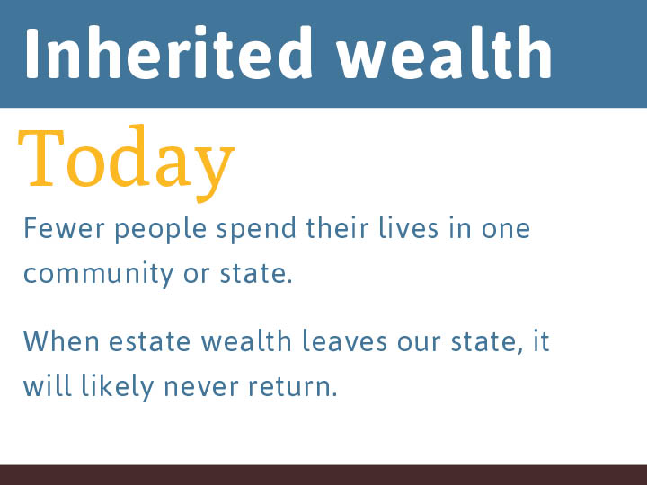

Slide 10
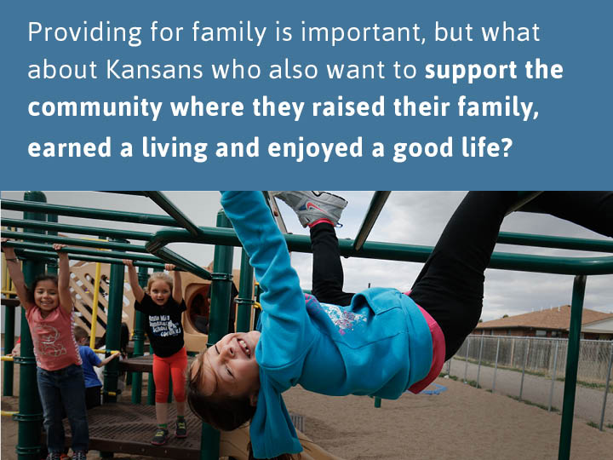

Slide 11
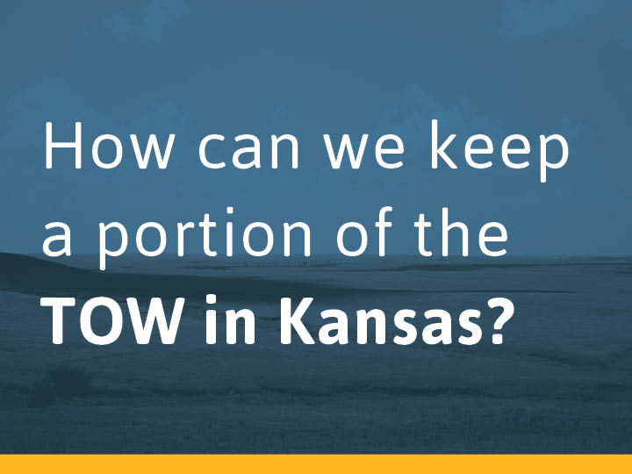

Slide 12
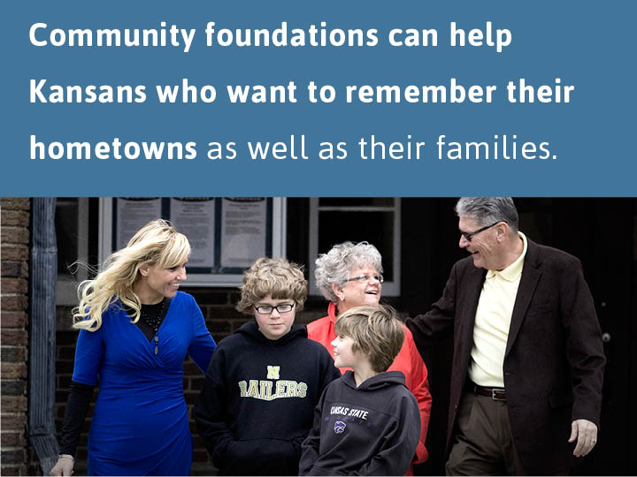

Slide 13


Slide 14
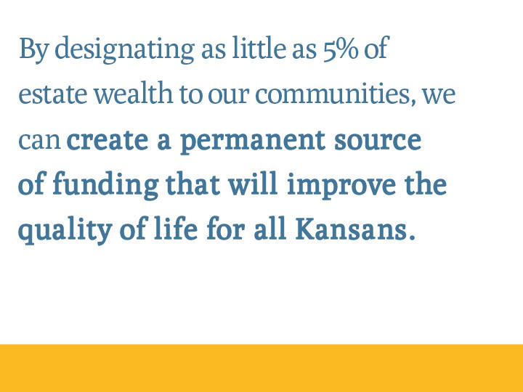

Slide 15
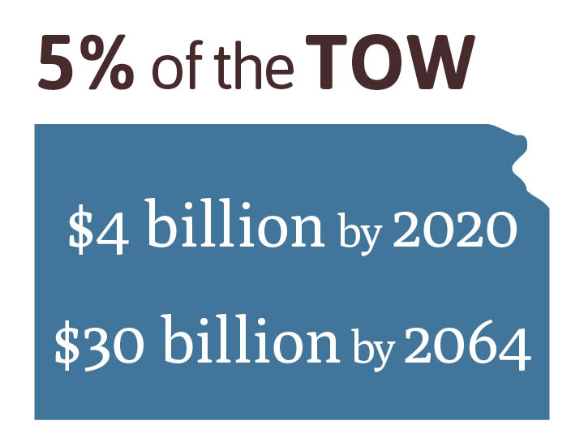
$23.3 billion by 2032

Slide 16
5% of the TOW in [COUNTY]
$[XX] million by 2023
$[XX thousand/million] by 2075

Slide 17

Keeping 5% in [COUNTY] can make a significant difference in the future of our communities.

Slide 18
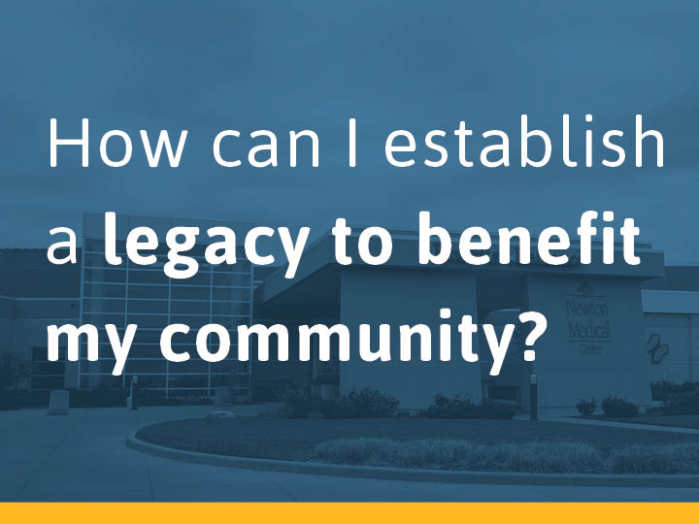

Slide 19
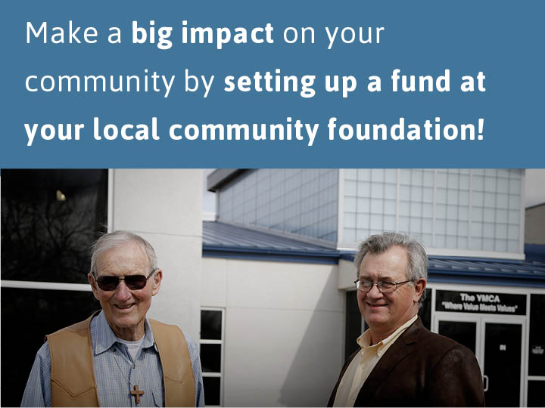

Slide 20
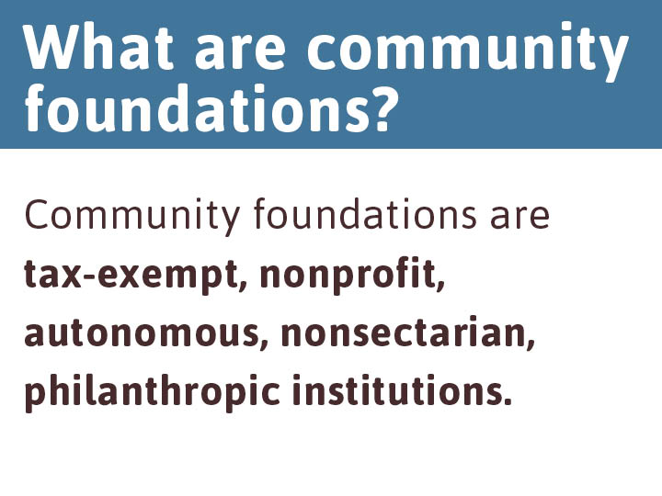

Slide 21
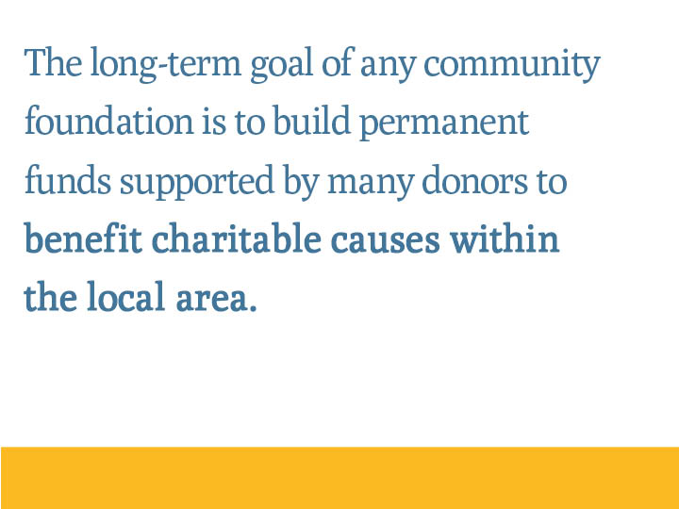

Slide 22
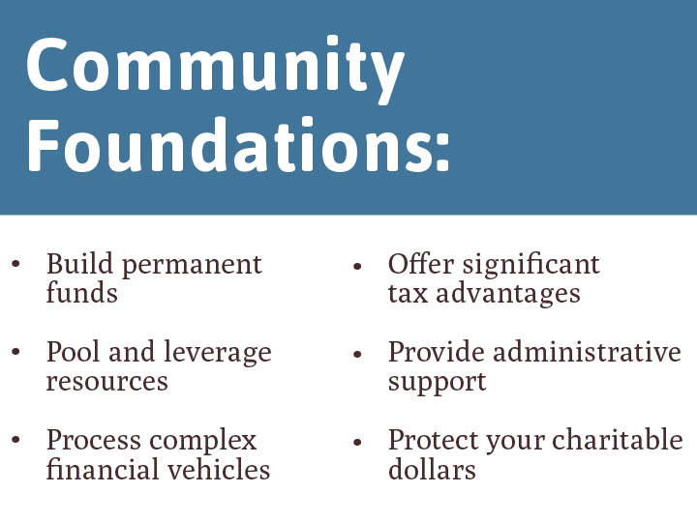

Slide 23

About [community foundation name]
[Place for community foundations to enter information about themselves, e.g., their logo/tagline, mission statement, when/how they were founded, etc.]

Slide 24
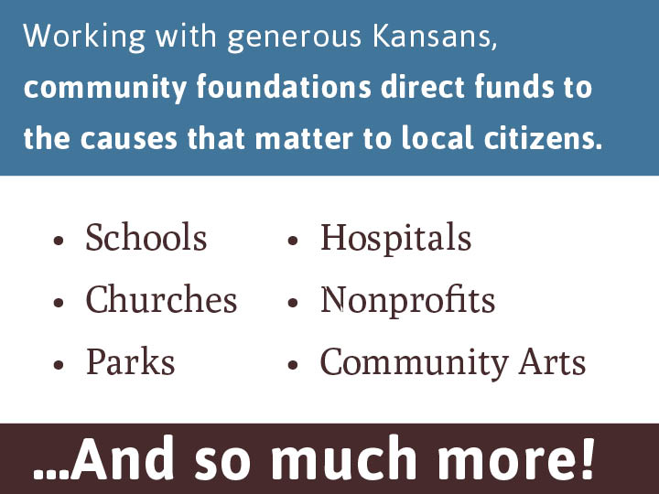

Slide 25
In recent years, the [community foundation] has awarded grants to:
Local Impact
[Examples of orgs/projects/causes supported by local CF]
[Possibly place for a testimonial]

Slide 26
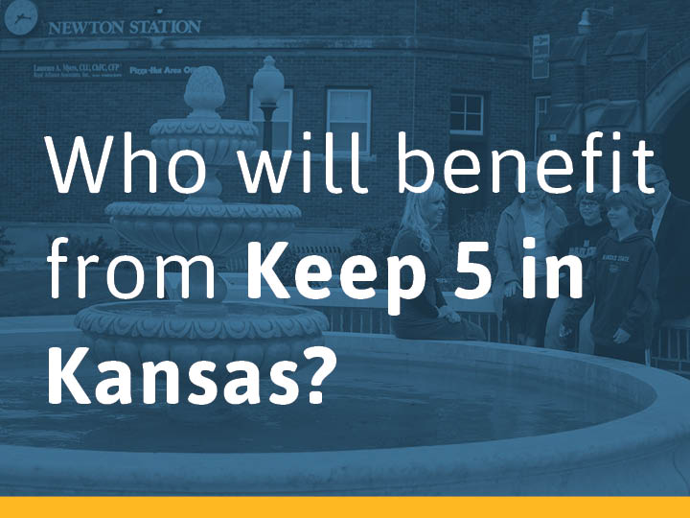

Slide 27
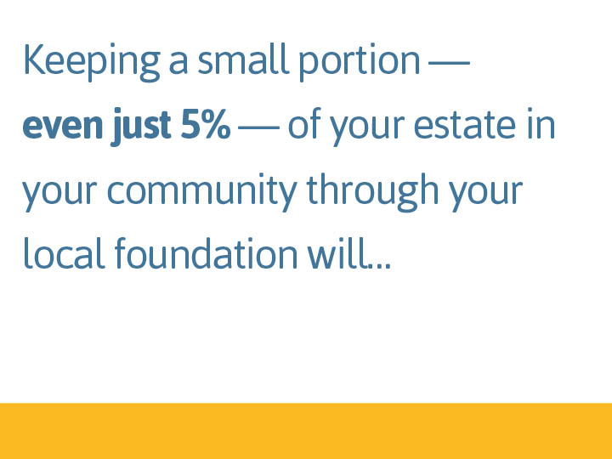

Slide 28
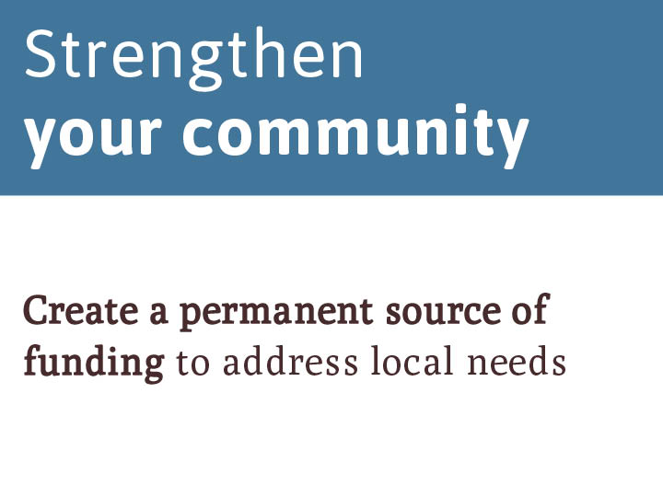

Slide 29
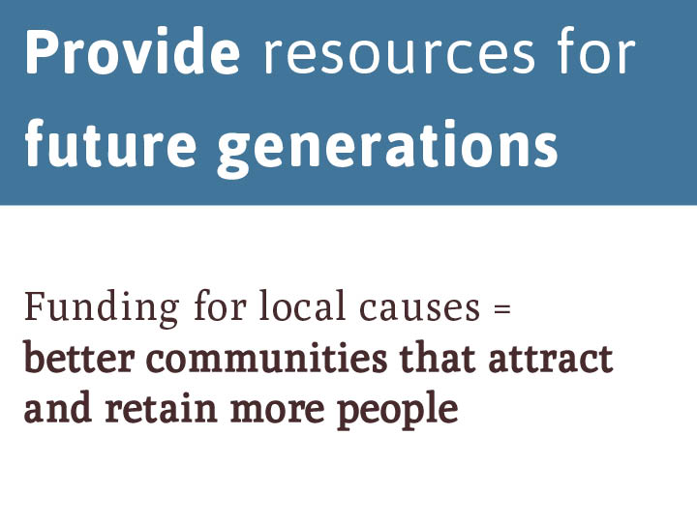

Slide 30
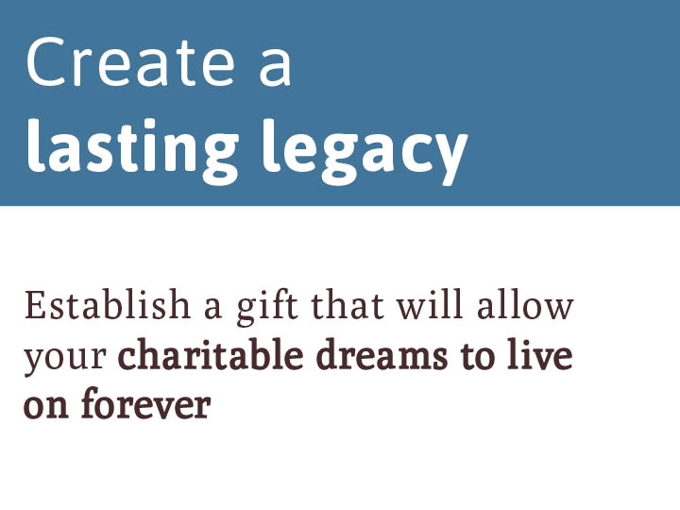

Slide 31
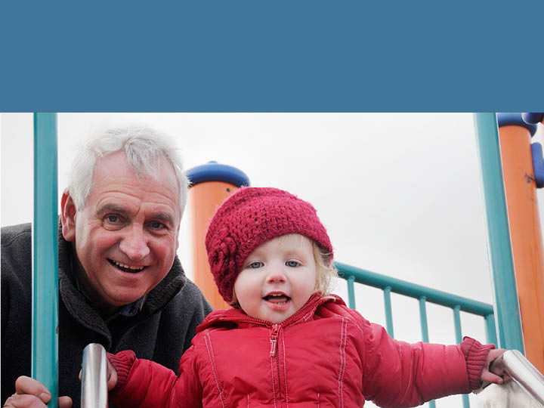
Together, we can make a bright future for the people who call [city/county/region] home.

Slide 32


Slide 33


